Slide 1
A Survey on Deep Learning Advances
for Time Series Forecasting
@GeminiLight

Slide 2
Content
Introduction
A
Classical Methods
B
DL-based Methods
C
Summary
E

Slide 3
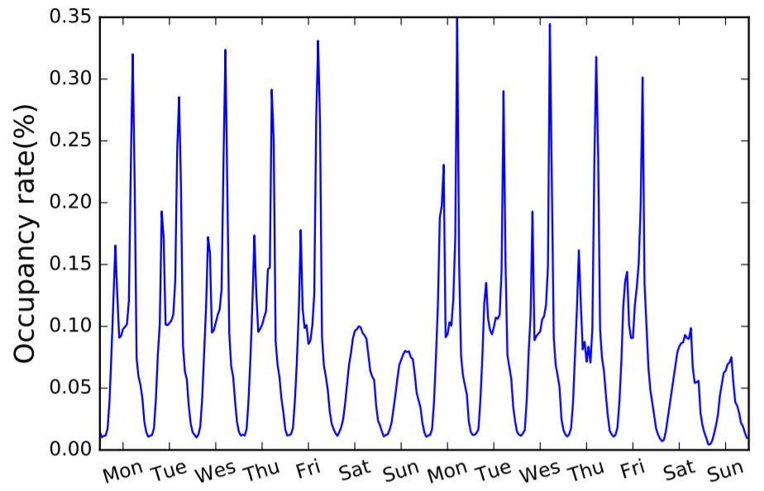
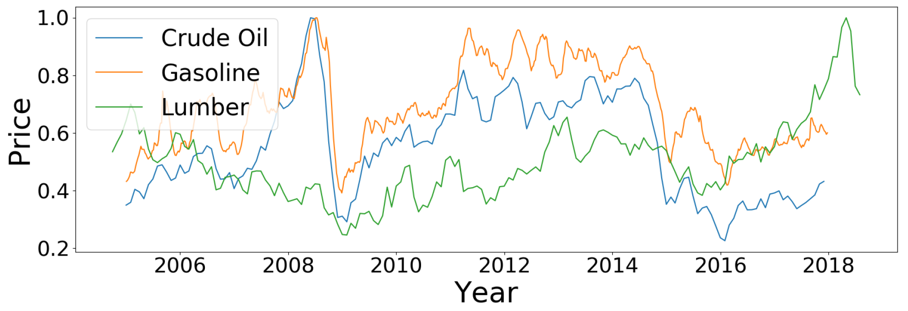
Introduction
Time Series
Types of Trends
Characteristic
Trend
Seasonal
Cyclical
Irregular
Given
$$X_{1},X_{2},…,X_{t}$$
High dimensionality
Much noise
Insufficient or unavailable
Find
$$Y_{t+Δ}$$
$$X_{t+Δ}$$
$$x_{i, t+Δ}$$
$x_{i, t+Δ}$, …, $x_{i, t+Δ′}$

Slide 4
Introduction
Categories
Forecasting step
Outputting results
One-step
Multi step
Single point
Probability
Inputting variables
Forecasting target
Autoregressive
Covariate
Univariate
Multivariate

Slide 5
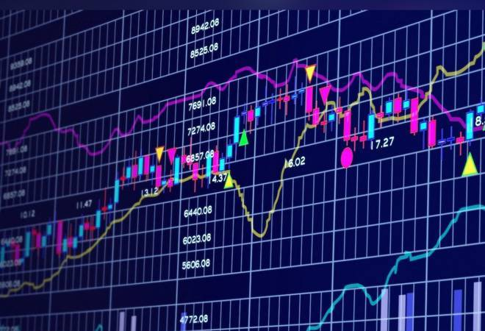
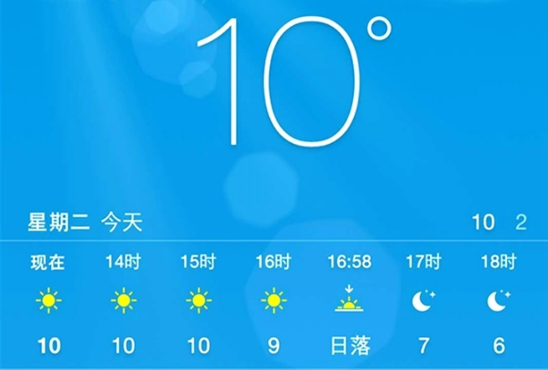
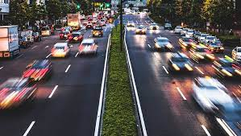
Introduction
Applications
Production Sales
Stock price
Weather forecast
Traffic flow
Implementation principle
Statistical methods
Machine learning
Support and can handle multivariate inputs
Capture complex nonlinear relationships
May not require a scaled or stationary time series as input
Statistical learning
Deep learning

Slide 6
Classical
AR (Auto Regressive)
$∅_{i}$: Autoregressive coefficient
$u_{t}$: White noise
$$x_{t}=∅_{1}x_{t−1}+∅_{2}x_{t−2}+⋯+∅_{p}x_{t−p}+u_{t}$$
MA (Moving Average)
$∅_{i}$: Moving regression coefficient
$u_{i}$: White noise
$$x_{t}=u_{t}+∅_{1}u_{t−1}+∅_{2}u_{t−2}+⋯+∅_{3}u_{t−q}$$
ARMA (Auto Regressive and Moving Average)
$$x_{t}=u_{t}+∅_{1}u_{t−1}+∅_{2}u_{t−2}+⋯+∅_{q}u_{t−q}+θ_{1}x_{t−1}+θ_{2}x_{t−2}+⋯+θ_{p}x_{t−p}$$
AR：the relationship between current data and later data
MA： random perturbation (noise)

Slide 7
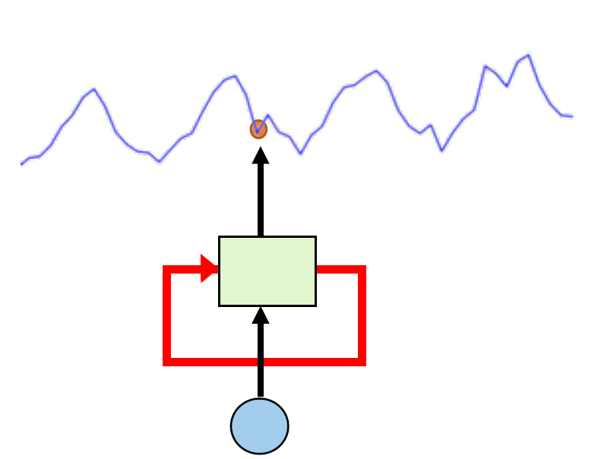
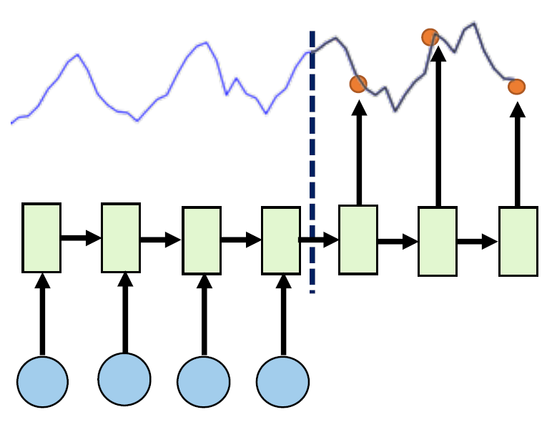
Basic Model
Canonical
Seq2Seq
Many-to-Many
One-to-One
$$f_{t}:x_{t}↦z_{t}$$
$$f:\left\{z_{1},⋯,z_{T_{e}}\right\}↦\left\{z_{T_{e}+1},⋯,z_{T_{e}+T_{d}}\right\}$$

Slide 8
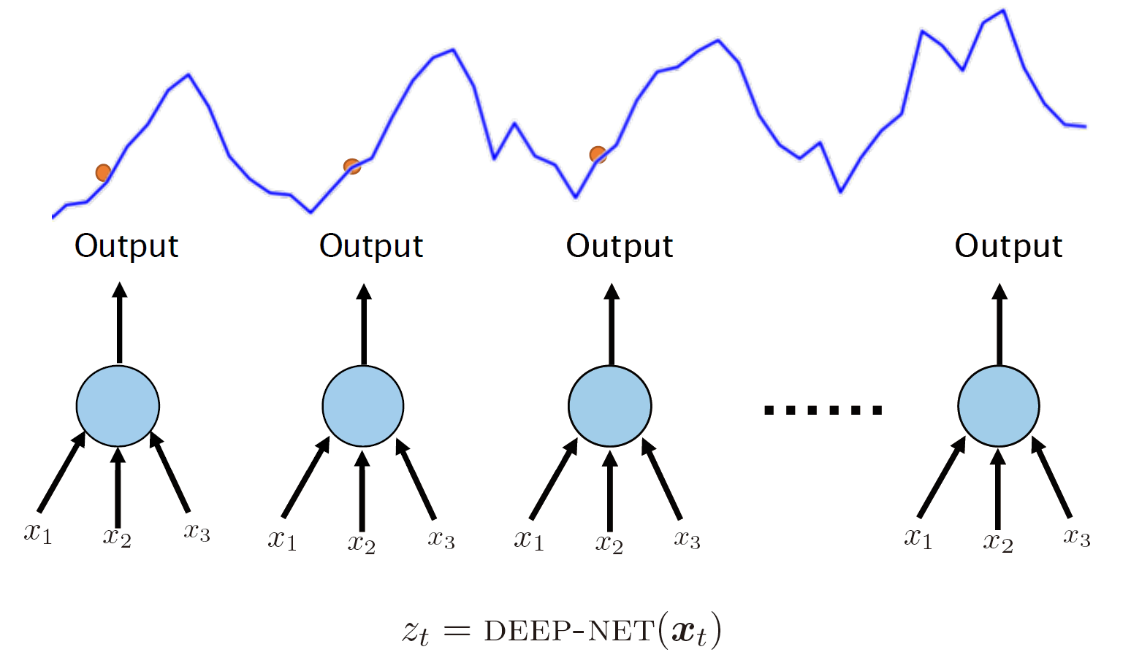
MLP
MLP
Sequential relationship？

Slide 9
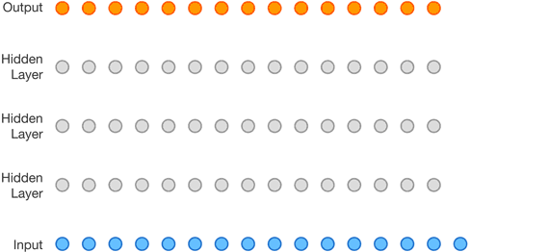
MLP
CNN
Long-Term Sequential relationship？
Image
from blog
by DeepMind
Yet there has been a lack of empirical evidence showing that this type of models can actually capture the temporal dependencies by discovering the latent hierarchical structure of the sequence
Aaron van den Oord et al. “WaveNet: A Generative Model for Raw Audio”. arXiv, 2016

Slide 10
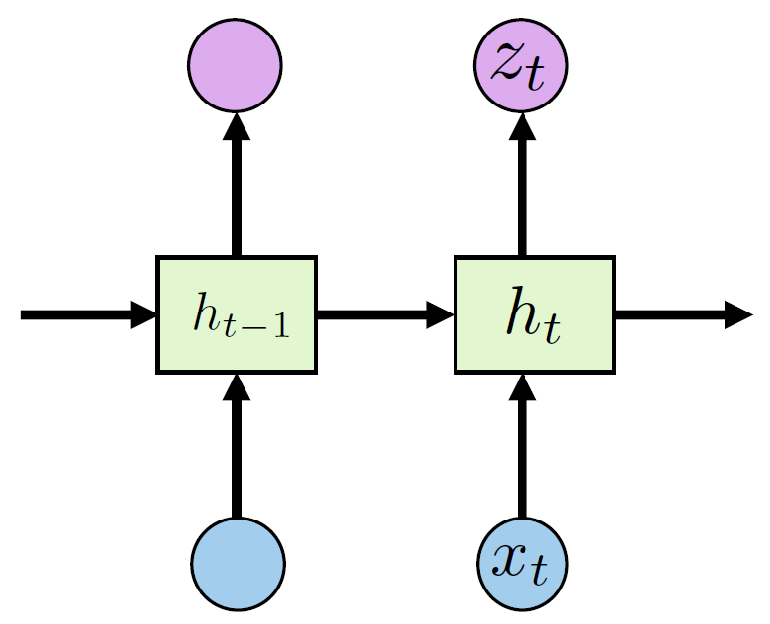
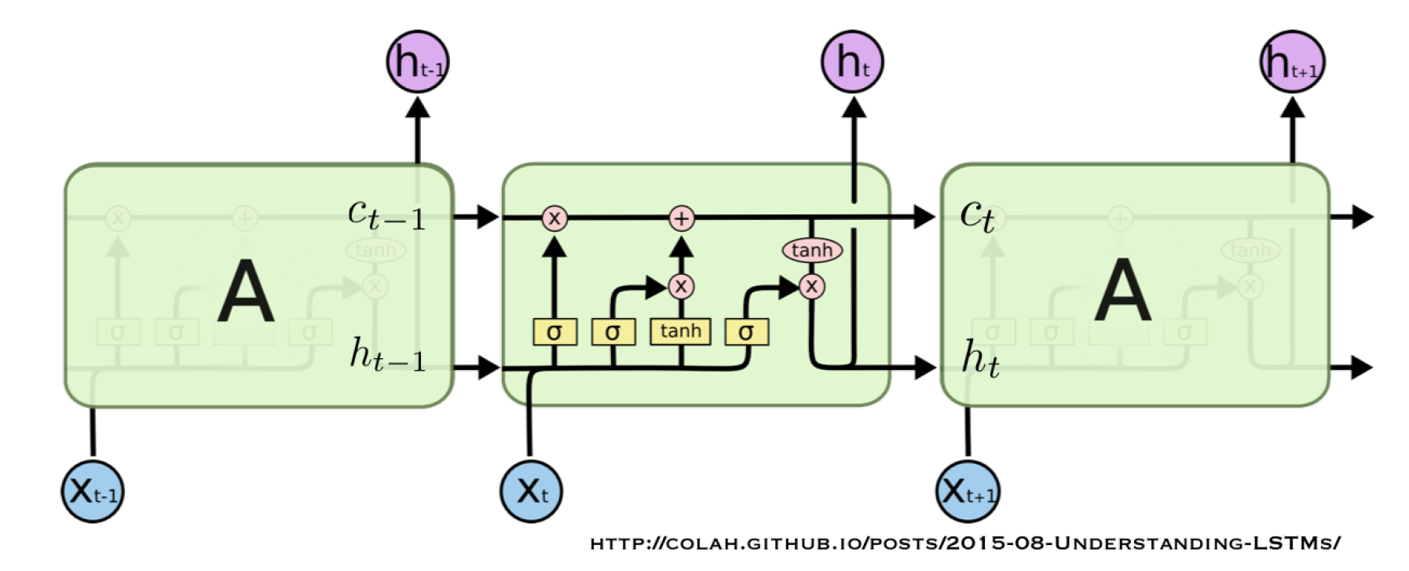
RNN
RNN
Today = yesterday’s information + new knowledge
Recurrent Neural Network (RNN)
Long Short-Term Memory (LSTM)
$$\begin{aligned}c^{t}&=z^{f}⋅⊙c^{t−1}+z^{i}⊙z \\ h^{t}&=z^{o}⊙tanh\left(c^{t}\right) \\ y^{t}&=σ\left(W^{′}h^{t}\right)\end{aligned}$$
$$C_{t}=α_{t}⋅C_{t−1}+β_{t}×σ\left(θ_{0}h_{t−1}+θ_{1}x_{t}\right)$$
current state = forget gate × old stuff + input gate × new stuff
$$\begin{aligned}h_{t}&=σ\left(θ_{0}h_{t−1}+θ_{1}x_{t}\right) \\ z_{t}&=σ\left(θh_{t}\right)\end{aligned}$$
Exponential Smoothing
$$s_{i}= \left(1−α\right)s_{i−1}+αx_{i}$$
hidden state: Change faster
cell state: Change slowly

Slide 11
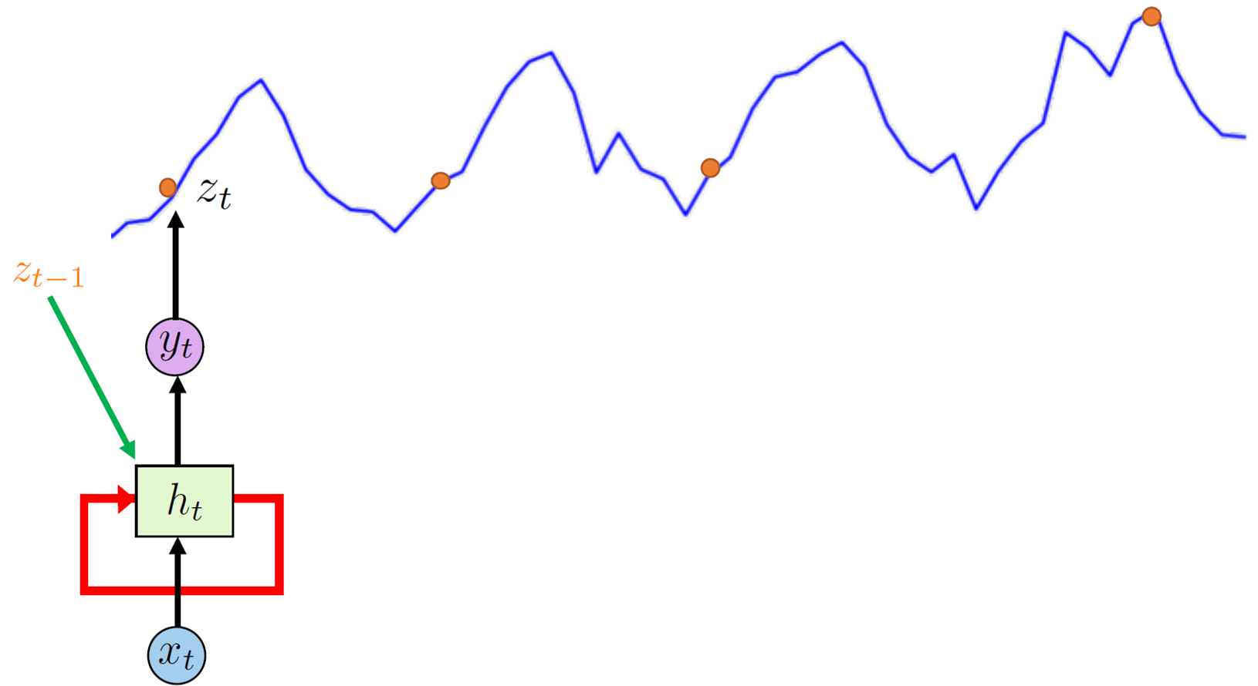
DeepAR
Similar to Autoregressive Input
$$h_{t−1}$$
Previous state
Current features
Last observed value
$$x_{t}$$
$$z_{t−1}$$
David Salinas et al. “DeepAR: Probabilistic Forecasting with Autoregressive Recurrent Networks”. arXiv, 2017

Slide 12
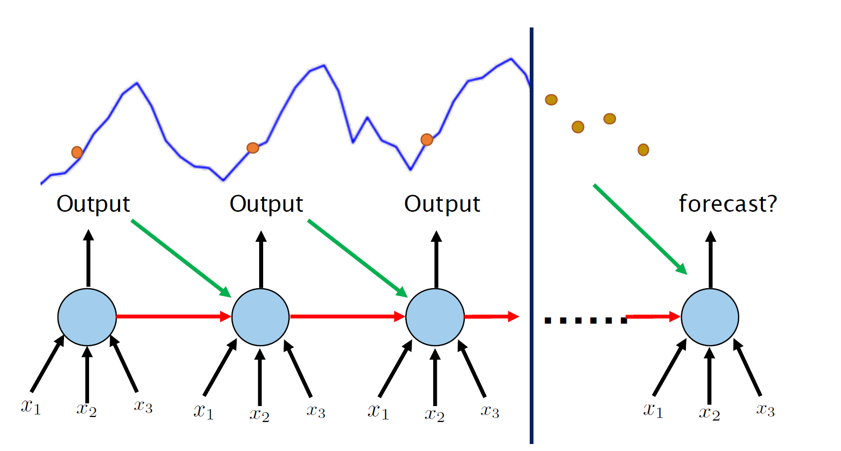
DeepAR
David Salinas et al. “DeepAR: Probabilistic Forecasting with Autoregressive Recurrent Networks”. arXiv, 2017

Slide 13
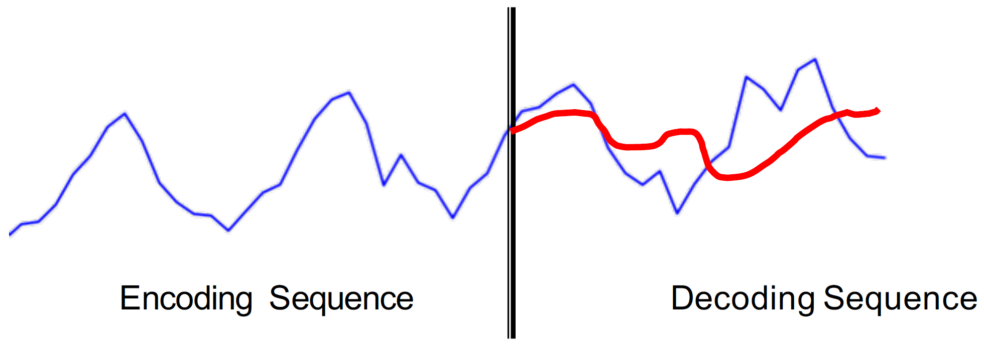
Seq2Seq
Encoder
Decoder
$$\begin{aligned}&f_{\text{encoder} }: \left\{z_{1},⋯,z_{T_{e}}\right\}↦h_{T_{e}} \\ &\end{aligned}$$
$$f_{\text{decoder} }: h_{T_{e}}↦\left\{z_{T_{e}+1},⋯,z_{T_{e}+T_{d}}\right\}$$

Slide 14
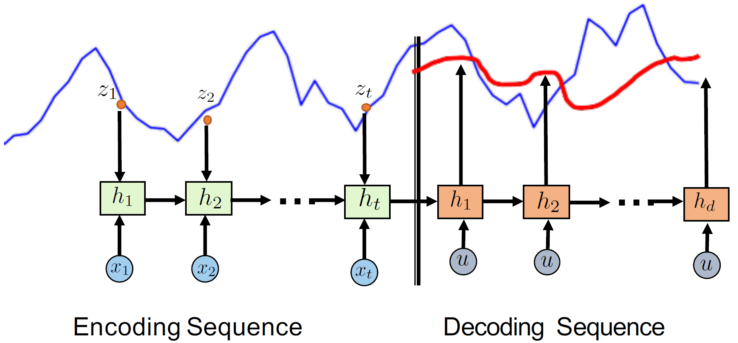
Seq2Seq
RNN-RNN

Slide 15
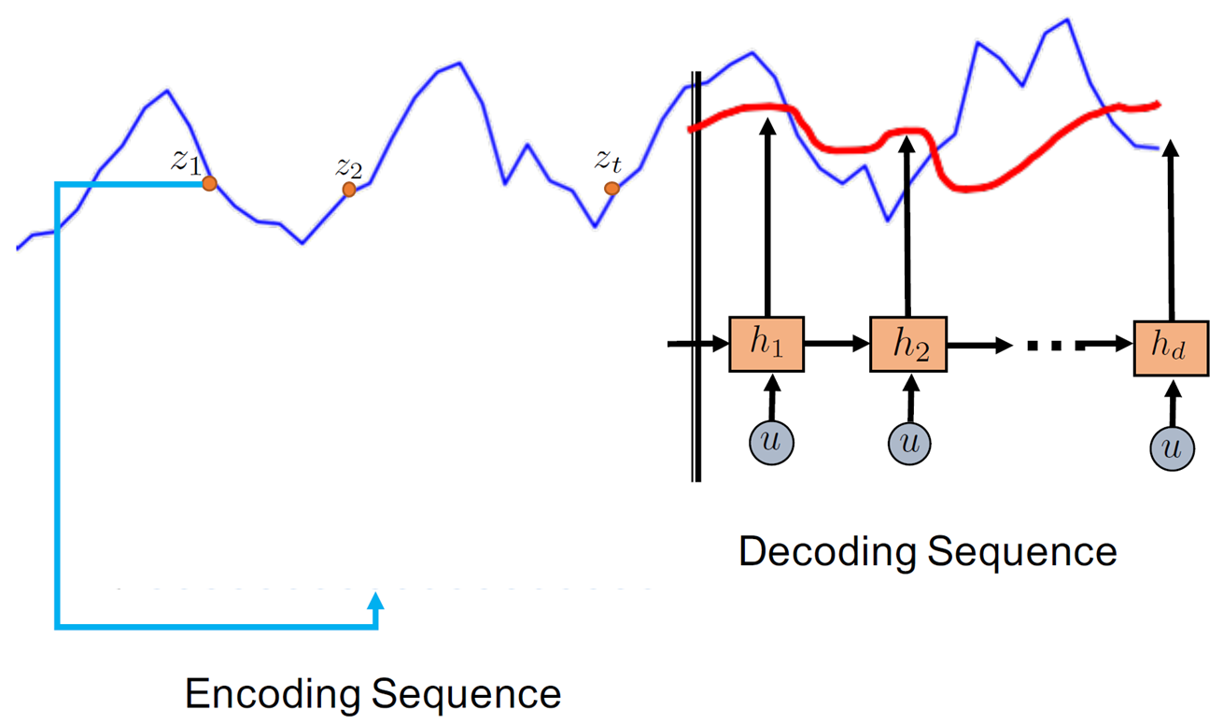
Seq2Seq
CNN-RNN

Slide 16
Attention

Slide 17
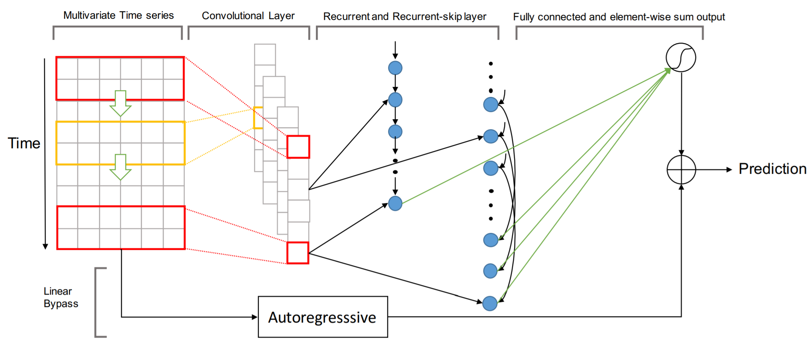
LSTNet
Input
CNN & AR
RNN & RNN-Skip
FC & Sum
Output
Non-linear
Neural Network
Recurring patterns
Linear
Autoregressive
Focus on local scaling
Long- and Short-term Time-series network (LSTNet)
Guokun Lai et al. “Modeling Long- and Short-Term Temporal Patterns with Deep Neural Networks”. In SIGIR, 2018 CCF-A

Slide 18
LSTNet
Input
CNN & AR
RNN & RNN-Skip
FC & Sum
Output
CNN
Autoregressive
Extract short-term patterns in the time dimension
as well as local dependencies between variables
CNN & RNN <- Non-linear nature
the scale of outputs is not sensitive to the scale of inputs
$$h_{t,i}^{L}={\sum{ }}_{k=0}^{q^{ar}−1} W_{k}^{ar}y_{t−k,i}+b^{ar}$$
Final Prediction
Guokun Lai et al. “Modeling Long- and Short-Term Temporal Patterns with Deep Neural Networks”. In SIGIR, 2018 CCF-A

Slide 19
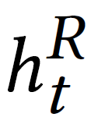
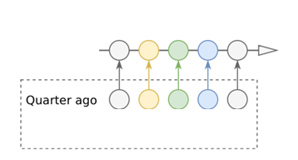
LSTNet
Input
CNN & AR
RNN & RNN-Skip
FC & Sum
Output
Recurrent Component
Recurrent-skip Component
Gated Recurrent Unit (GRU)
GRU and LSTM usually fail to capture very long-term correlation in practice
period
Guokun Lai et al. “Modeling Long- and Short-Term Temporal Patterns with Deep Neural Networks”. In SIGIR, 2018 CCF-A

Slide 20
LSTNet
Input
CNN & AR
RNN & RNN-Skip
FC & Sum
Output
MLP aggregation
Recurrent Component
Recurrent-skip Component
Guokun Lai et al. “Modeling Long- and Short-Term Temporal Patterns with Deep Neural Networks”. In SIGIR, 2018 CCF-A

Slide 21
LSTNet
Input
CNN & AR
RNN & RNN-Skip
FC & Sum
Output
period length is dynamic？
Recurrent Component
Temporal Attention
Guokun Lai et al. “Modeling Long- and Short-Term Temporal Patterns with Deep Neural Networks”. In SIGIR, 2018 CCF-A

Slide 22
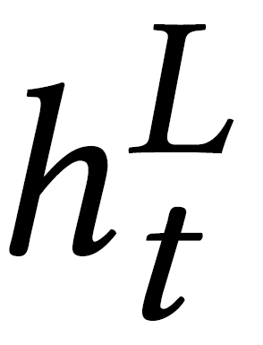
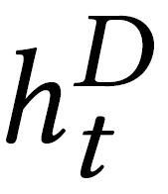
LSTNet
Input
CNN & AR
RNN & RNN-Skip
FC & Sum
Output
Non-linear
Neural Network
Recurring patterns
Linear
Autoregressive
Focus on local scaling
Long- and Short-term Time-series network (LSTNet)
Final Prediction
Guokun Lai et al. “Modeling Long- and Short-Term Temporal Patterns with Deep Neural Networks”. In SIGIR, 2018 CCF-A

Slide 23
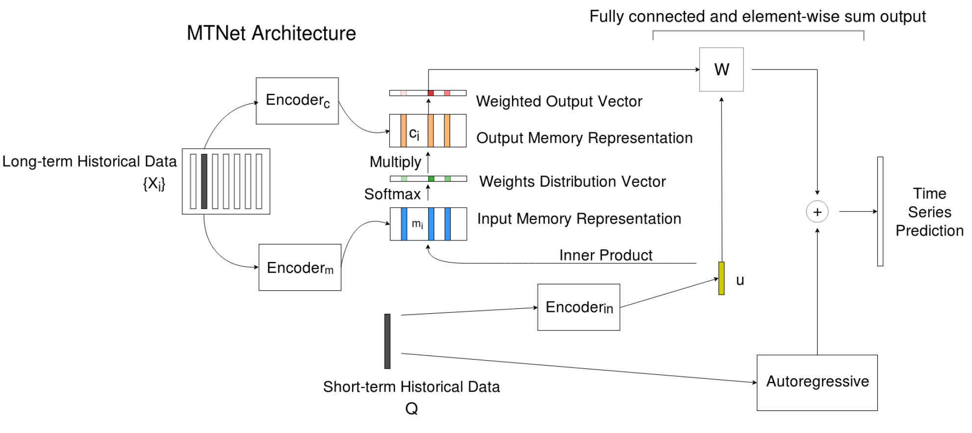
MTNet
Memory Time-series Network (MTNet)
Yen-Yu Chang et al. “A Memory-Network Based Solution for Multivariate Time-Series Forecasting”. In AAAI, 2019 CCF-A

Slide 24
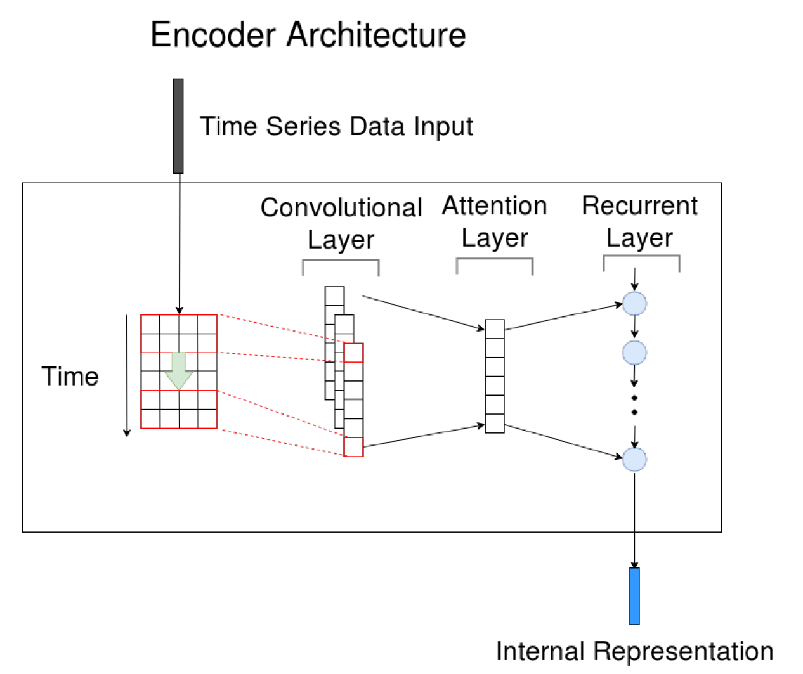
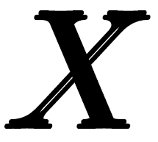
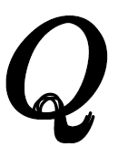
MTNet
Encoder
a set of long-term time series
a short-term historical time series
Memory Time-series Network (MTNet)
Yen-Yu Chang et al. “A Memory-Network Based Solution for Multivariate Time-Series Forecasting”. In AAAI, 2019 CCF-A

Slide 25
MTNet
X
Encoder
Q
Memory Time-series Network (MTNet)
Yen-Yu Chang et al. “A Memory-Network Based Solution for Multivariate Time-Series Forecasting”. In AAAI, 2019 CCF-A

Slide 26
MTNet
Attention
Memory Time-series Network (MTNet)
Yen-Yu Chang et al. “A Memory-Network Based Solution for Multivariate Time-Series Forecasting”. In AAAI, 2019 CCF-A

Slide 27
MTNet
Attention
Memory Time-series Network (MTNet)
Yen-Yu Chang et al. “A Memory-Network Based Solution for Multivariate Time-Series Forecasting”. In AAAI, 2019 CCF-A

Slide 28
MTNet
Aggregation
Memory Time-series Network (MTNet)
Yen-Yu Chang et al. “A Memory-Network Based Solution for Multivariate Time-Series Forecasting”. In AAAI, 2019 CCF-A

Slide 29
MTNet
Autoregressive
Memory Time-series Network (MTNet)
Yen-Yu Chang et al. “A Memory-Network Based Solution for Multivariate Time-Series Forecasting”. In AAAI, 2019 CCF-A

Slide 30
TPA-LSTM
MLP
y
LSTM
Temporal Pattern Attention
Attention
Time steps
Inputting Variables
Shun-Yao Shih et al. “Temporal Pattern Attention for Multivariate Time Series Forecasting”. In ECML PKDD, 2018 CCF-B

Slide 31
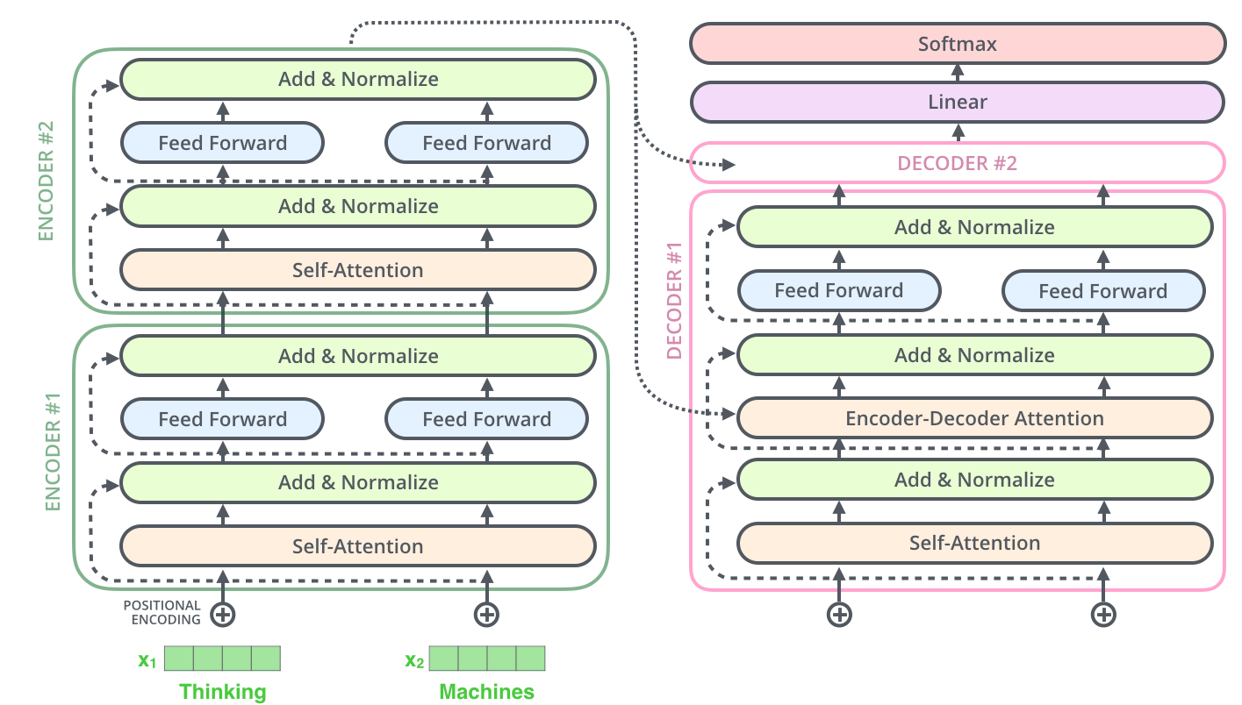
Transformer
Image from Blog by Jalammar
A Vaswani et al. “Attention Is All You Need”. In NeurIPS, 2017 CCF-A

Slide 32
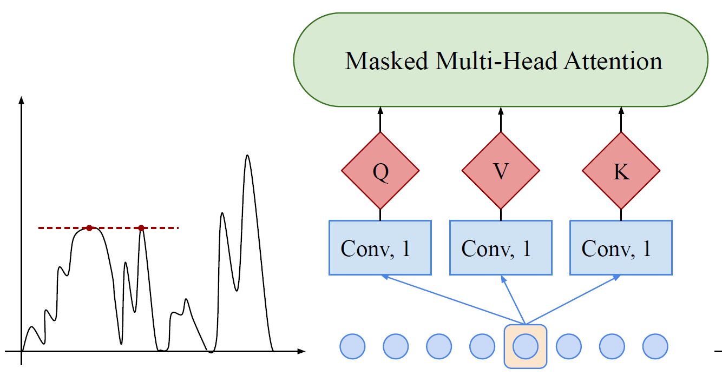
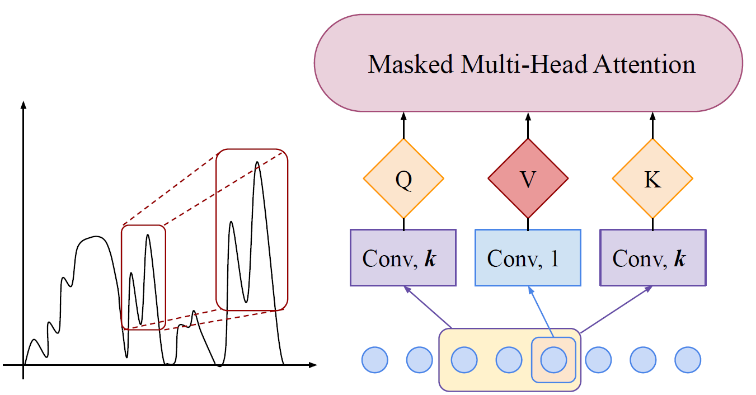
Transformer
Enhancing the locality of Transformer
Canonical self-attention
Convolutional self-attention
Shiyang Li et al. “Enhancing the Locality and Breaking the Memory Bottleneck of Transformer on Time Series Forecasting”. In NeurIPS, 2019 CCF-A

Slide 33
Transformer
Breaking the memory bottleneck of Transformer
Shiyang Li et al. “Enhancing the Locality and Breaking the Memory Bottleneck of Transformer on Time Series Forecasting”. In NeurIPS, 2019 CCF-A

Slide 34
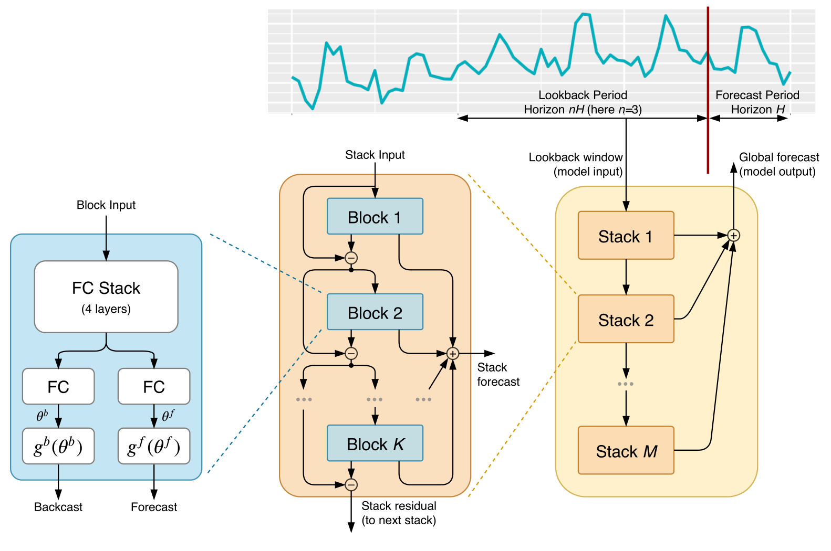
N-BEATS
Boris N. Oreshkin et al. “N-BEATS: Neural basis expansion analysis for interpretable time series forecasting”. In ICLR, 2020 CCF-A

Slide 35
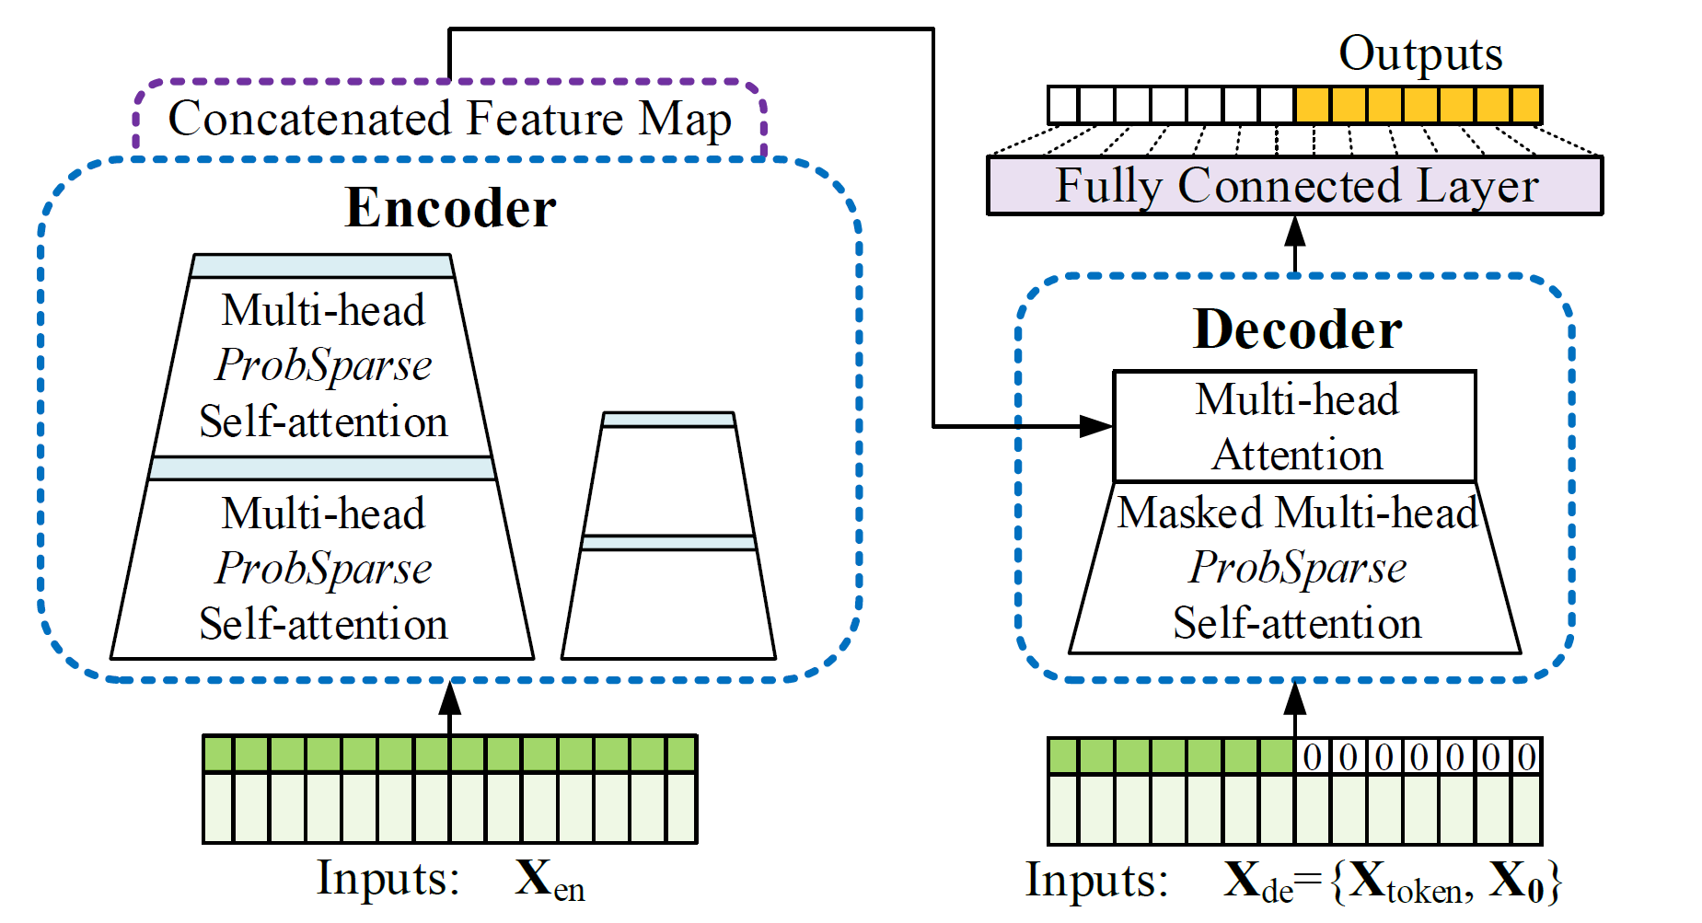
Informer
Haoyi Zhou et al. “Informer: Beyond Efficient Transformer for Long Sequence Time-Series Forecasting”. In AAAI, 2021 CCF-A

Slide 36
Informer
Self-attention Distilling operation
Start token is efficiently applied in NLP’s “dynamic decoding”
start token
contains target sequence’s time stamp,
i.e., the context at the target week
Haoyi Zhou et al. “Informer: Beyond Efficient Transformer for Long Sequence Time-Series Forecasting”. In AAAI, 2021 CCF-A

Slide 37
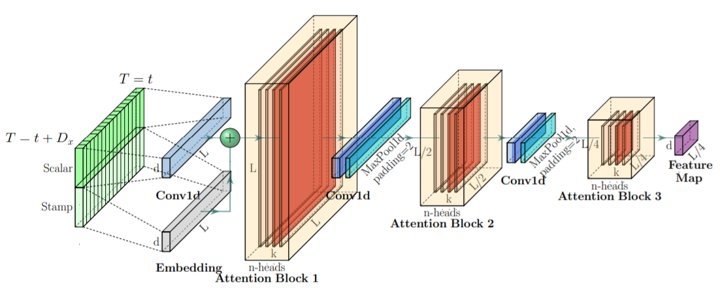
Informer
Generative-style decoder
Haoyi Zhou et al. “Informer: Beyond Efficient Transformer for Long Sequence Time-Series Forecasting”. In AAAI, 2021 CCF-A

Slide 38
MTGNN
spatial
Graph learning module
extracts a sparse graph adjacency matrix adaptively based on data.
Graph convolution module
address the spatial dependencies among variables
Temporal convolution module
capture temporal patterns by modified 1D convolutions
spatial
temporal
Zonghan Wu et al. “Connecting the Dots: Multivariate Time Series Forecasting with Graph Neural Networks”. In KDD, 2020 CCF-A

Slide 39
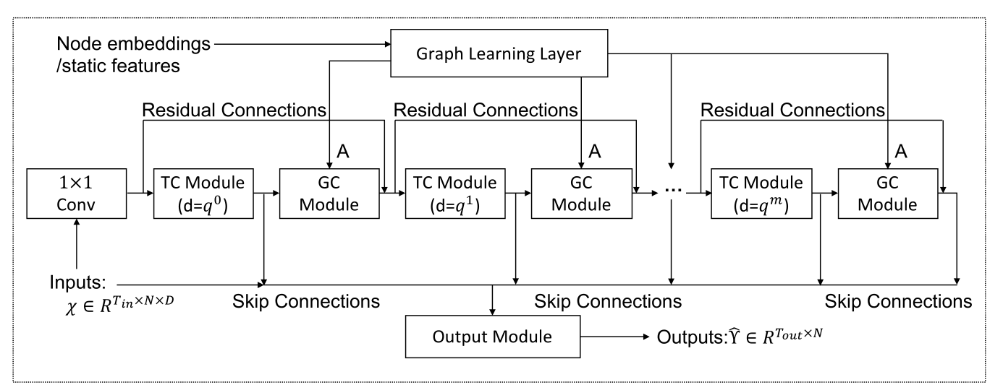
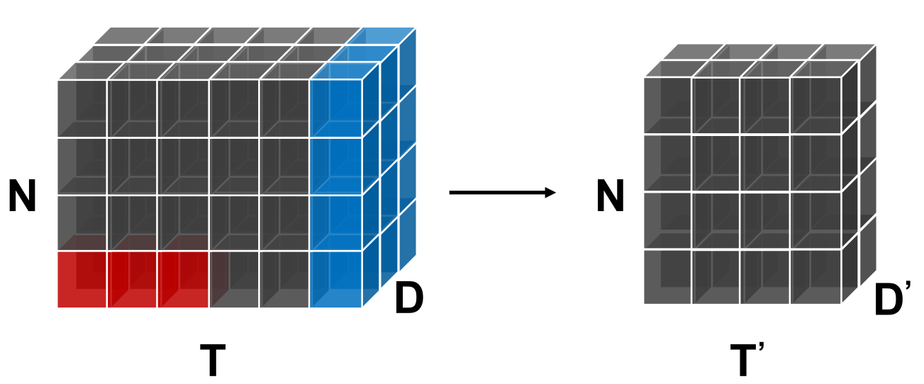
MTGNN
Zonghan Wu et al. “Connecting the Dots: Multivariate Time Series Forecasting with Graph Neural Networks”. In KDD, 2020 CCF-A

Slide 40
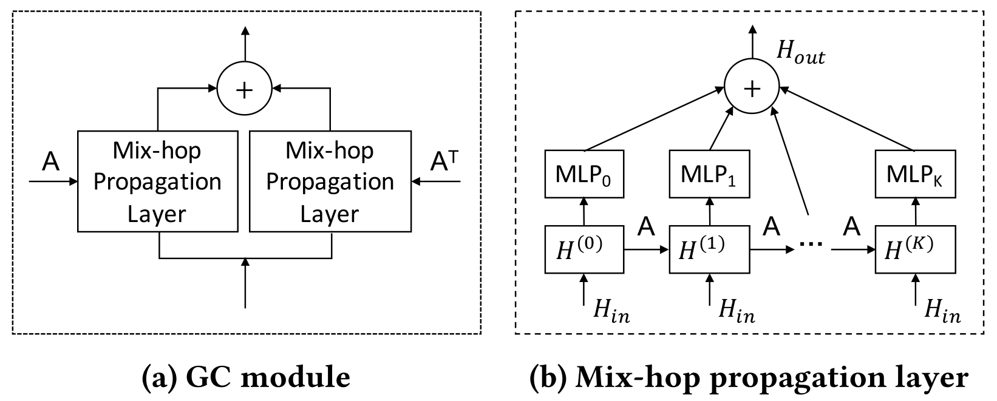
MTGNN
GC module
Zonghan Wu et al. “Connecting the Dots: Multivariate Time Series Forecasting with Graph Neural Networks”. In KDD, 2020 CCF-A

Slide 41
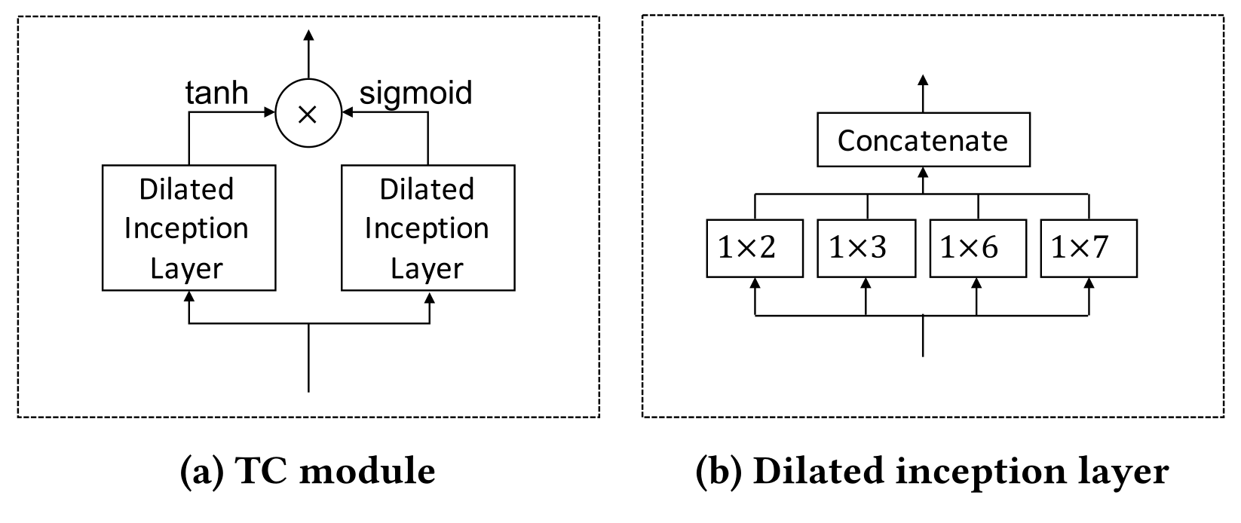
MTGNN
TC module
Zonghan Wu et al. “Connecting the Dots: Multivariate Time Series Forecasting with Graph Neural Networks”. In KDD, 2020 CCF-A

Slide 42
MTGNN
Zonghan Wu et al. “Connecting the Dots: Multivariate Time Series Forecasting with Graph Neural Networks”. In KDD, 2020 CCF-A

Slide 43
MTAD-GAT
Hang Zhao et al. “Multivariate Time-series Anomaly Detection via Graph Attention Network”. In ICDM, 2020 CCF-B

Slide 44
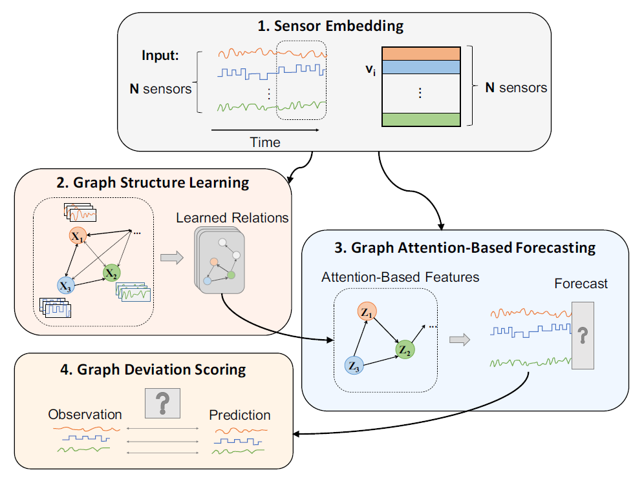
GDN
Ailin Deng et al. “Graph Neural Network-Based Anomaly Detection in Multivariate Time Series”. In AAAI, 2021 CCF-A

Slide 45
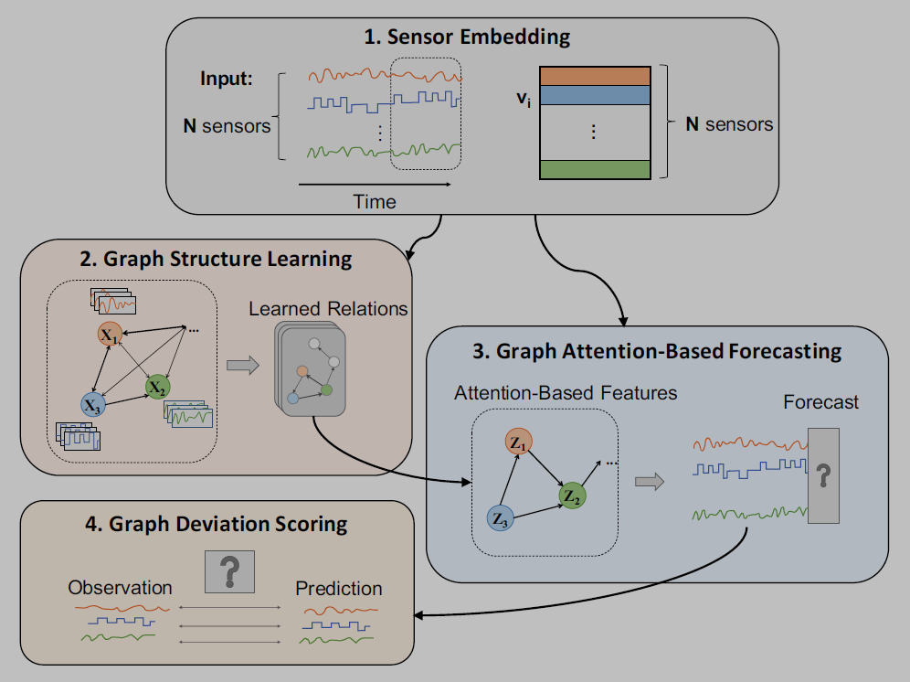
GDN
1. Sensor Embedding
Capture the unique characteristics of each sensor
$$\left.v_{i}∈ℝ^{d}, \text{for} i∈\{1,2,⋅⋯,N\right\}$$
USE
1) For structure learning
To determine which sensors are related to one another
2) In attention mechanism
To perform attention over neighbors in a way that allows heterogeneous effects for different types of sensors
Ailin Deng et al. “Graph Neural Network-Based Anomaly Detection in Multivariate Time Series”. In AAAI, 2021 CCF-A

Slide 46
GDN
2. Graph Structure Learning
Directed
graph
edges
sensors
learns a graph structure representing dependence relationships between sensors
nodes
dependency relationships
For each sensor $i$
1) candidate relations
$$\left.𝒞_{i}⊆\{1,2,⋯,N\}∖\{i\right\}$$
2) compute the similarity
$$e_{ji}=\frac{v_{i}^{⊤}v_{j}}{\left.∥v_{i}∥\right.⋅\left.∥v_{j}∥\right.} \text{for} j∈𝒞_{i}$$
3) select edges
$$A_{ji}=1\left\{j∈TopK\left(\left\{e_{ki}:k∈𝒞_{i}\right\}\right)\right\}$$
Get Adjacency matrix A
Ailin Deng et al. “Graph Neural Network-Based Anomaly Detection in Multivariate Time Series”. In AAAI, 2021 CCF-A

Slide 47
GDN
3. Graph Attention-Based Forecasting
forecasts future values of each sensor
based on a graph attention function over its neighbors
1) Input
2) Feature Extractor
3) Output
a sliding window of size $w$
over the historical time series data
$$x^{\left(t\right)}:=\left[s^{\left(t−w\right)},s^{\left(t−w+1\right)},⋯,s^{\left(t−1\right)}\right]$$
target output
sensor data at the current time tick，i.e. $s^{\left(t−w\right)}$
Ailin Deng et al. “Graph Neural Network-Based Anomaly Detection in Multivariate Time Series”. In AAAI, 2021 CCF-A

Slide 48
GDN
3. Graph Attention-Based Forecasting
forecasts future values of each sensor
based on a graph attention function over its neighbors
1) Input
2) Feature Extractor
3) Output
Aggregated representation $z_{i}^{ }$
$$z_{i}^{\left(t\right)}=ReL{U}\left(α_{i,i}Wx_{i}^{\left(t\right)}+\sum_{\left.j∈𝒩(i\right)}{ }α_{i,j}Wx_{j}^{\left(t\right)}\right)$$
$$\begin{aligned}g_{i}^{\left(t\right)}&=v_{i}⊕Wx_{i}^{\left(t\right)} \\ π(i,j)&= \text{LeakyReLU} \left(a^{⊤}\left(g_{i}^{\left(t\right)}⊕g_{j}^{\left(t\right)}\right)\right) \\ α_{i,j}&=\frac{\left.exp{(}π(i,j)\right)}{\left.\sum_{\left.k∈𝒩(i)∪\{i\right\}}{ }exp{(}π(i,k)\right)}\end{aligned}$$
compute
attention
coefficients
Ailin Deng et al. “Graph Neural Network-Based Anomaly Detection in Multivariate Time Series”. In AAAI, 2021 CCF-A

Slide 49
GDN
3. Graph Attention-Based Forecasting
forecasts future values of each sensor
based on a graph attention function over its neighbors
1) Input
2) Feature Extractor
3) Output
Representations of $N$ nodes
$$\left\{z_{1}^{\left(t\right)},⋯,z_{N}^{\left(t\right)}\right\}$$
Target output
$${\hat{s}}^{\left(t\right)}=f_{θ}\left(\left[v_{1}∘z_{1}^{\left(t\right)},⋯,v_{N}∘z_{N}^{\left(t\right)}\right]\right)$$
output dimensionality $N$
Mean Squared Error
$$L_{MSE}=\frac{1}{T_{\text{train} }−w}\sum_{t=w+1}^{T_{\text{train} }}{ }{\left.∥{\hat{s}}^{\left(t\right)}−s^{\left(t\right)}∥\right.}_{2}^{2}$$
Ailin Deng et al. “Graph Neural Network-Based Anomaly Detection in Multivariate Time Series”. In AAAI, 2021 CCF-A

Slide 50
GDN
4. Graph Deviation Scoring
Anomaly Detection
identifies deviations from the learned relationships, and localizes and explains these deviations.
1) Computing an error value
$t$time
$i$sensor
$${Err}_{i}{(}t)=\left|s_{i}^{\left(t\right)}−{\hat{s}}_{i}^{\left(t\right)}\right|$$
2) Perform a robust normalization
$$a_{i}(t)=\frac{{Err}_{i}{(}t)−{\tilde{μ}}_{i}}{{\tilde{σ}}_{i}}$$
${\tilde{μ}}_{i}$median
${\tilde{σ}}_{i}$IQR2
3) Aggregate over sensors
max
function
$$A(t)=\max_{i} a_{i}(t)$$
4) Generate the smoothed scores
$$A_{s}\left(t\right)=SMA(A(t))$$
5) labelled as an anomaly
If$A_{s}\left(t\right)>THRESHOLD$
Ailin Deng et al. “Graph Neural Network-Based Anomaly Detection in Multivariate Time Series”. In AAAI, 2021 CCF-A

Slide 51
GDN
Ailin Deng et al. “Graph Neural Network-Based Anomaly Detection in Multivariate Time Series”. In AAAI, 2021 CCF-A

Slide 52
Summary
DL for TS
CNN
CONV
Pooling
RNN
LSTM
GRU
Transformer
GNN
Other…
Seq2Seq
Attention
GCN
GAT
GAN
DRL
Thanks
A Survey on Deep Learning Advances
for Time Series Forecasting
@GeminiLight

